Slide 1
React
Redux Toolkit
Mahhek Tahir
Notes:
.

Slide 2
Redux
Redux is a state management library for JavaScript applications, mainly used with React.
It helps you manage and store data in a central place instead of passing it between components manually.
Think of it like a storage box where all your app’s data is kept in one place, so every part of your app can access it easily.

Slide 3
Why do we need Redux?
Without Redux (Normal React State)
Each component manages its own state using useState().
Passing data between components requires props drilling (passing props from parent → child → child).
Managing complex states like user authentication, or shopping carts.
With Redux
Redux stores all the state in a single place (Store).
Any component can access or update the state easily.
No need for props drilling!

Slide 4
Redux Toolkit
Redux Toolkit (RTK) is the official way to write Redux code easier and faster. It reduces boilerplate code and makes Redux simpler to use.
Traditional Redux → Too much setup (Actions, Reducers, Store separately) Redux Toolkit → All in one place (createSlice())
npm install @reduxjs/toolkit react-redux

Slide 5
Key concepts of Redux Toolkit
Store (Central place for state)
The global state of your app.
Components get data from and send updates to the store.
Actions (Tell Redux what to do)
Actions are messages that tell Redux what changes should happen
Reducers (Update the state)
Pure Functions that modify the store when actions are dispatched.
In RTK, reducers are inside createSlice()
Dispatch (Send actions to update the state)
Used in components to trigger actions.
Selectors (Read data from the store)
Used in components to get data from Redux (useSelector()).

Slide 6
Example
Store → A big container that stores all the state (data). Selectors → Functions that extract specific data from the store. Actions → Instructions that tell Redux what to change (like “increase the counter”). Dispatcher → Triggers actions and tells Redux, "Hey, do this now!" Reducers → The actual workers that update the state based on the action.
Example: If you click a "Like" button in an app:
Action → "Like Post"
Dispatcher → Sends "Like Post" to Redux
Reducer → Increases the like count in the store
Selector → Gets the updated like count to show on the screen

Slide 7
Pure function in Redux
A pure function in Redux (or in general programming) is a function that:
1. Always returns the same output for the same input – No randomness or dependence on external variables.
2. Has no side effects – It doesn’t modify external state, make API calls, or mutate data.
3. In Redux, reducers must be pure functions because they take the current state and an action, then return a new state without modifying the existing state.

Slide 8
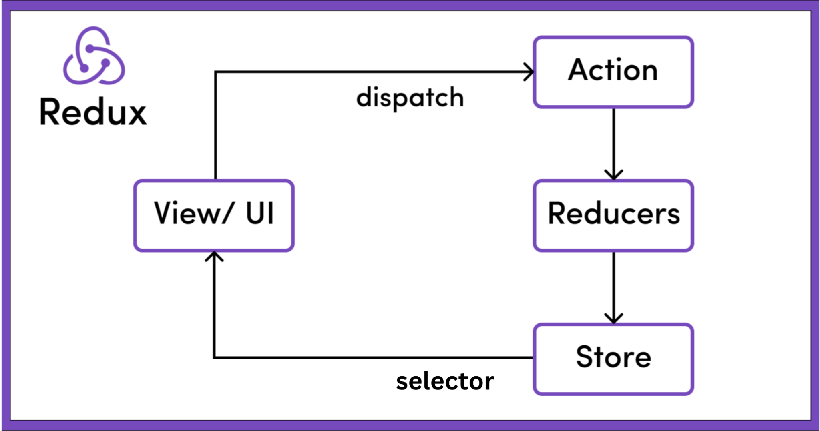
Diagram

Slide 9
Slice (action + reducer)
A slice in Redux Toolkit is like a state variable but with built-in actions and an initial value.
With createSlice(), reducers and actions are defined together inside a single slice.
Think of this like
const [counter, setCounter] = useState(0);
but for global state, where counter also has actions like increment and decrement.
Redux Slice = State + Actions in One Place
When you create a slice:
You define a state variable (counter with an initial value).
You define actions (increment, decrement).
Redux handles updating the state for you.

Slide 10
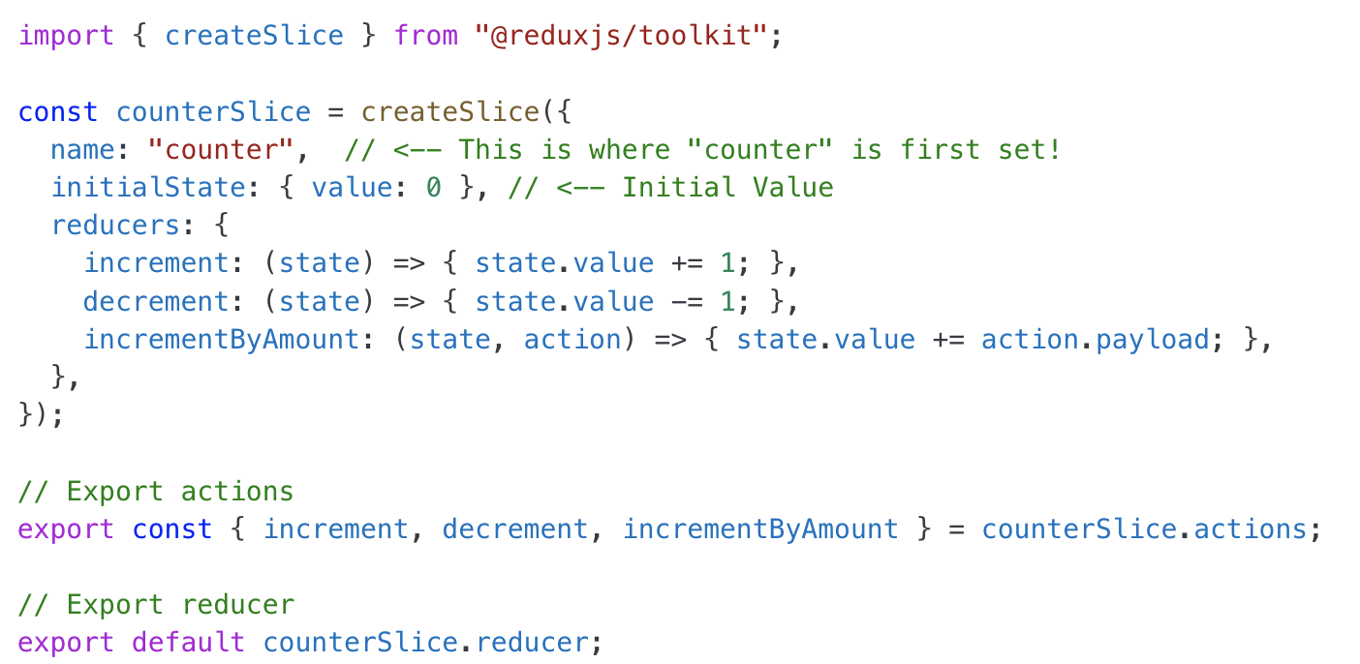
Slice Example (counterSlice.js)

Slide 11
Store
The Redux store is like a central database for your app. It holds all the global state and allows components to read data or update the state by dispatching actions.
Holds the entire state of the application Allows access to state via useSelector Allows state updates via dispatch(action) Uses reducers to modify the state

Slide 12
Selector
A selector is a function used to retrieve data from the Redux store. It helps in reading and using the state inside React components.
const count = useSelector((state) => state.counter.value); // Selecting counter value
const user = useSelector((state) => state.user); // Selecting user object
useSelector takes a function that returns a part of the Redux state.
Avoid directly selecting the whole store, pick only needed values.

Slide 13
Dispatcher
A dispatcher is a function that sends actions to the Redux store to update state.
We use useDispatch from Redux Toolkit to trigger actions.
return (
<div>
<button onClick={() => dispatch(increment())}>+ Increment</button>
<button onClick={() => dispatch(decrement())}>- Decrement</button>
</div>
);
dispatch(action()) calls an action that updates the state.

Slide 14
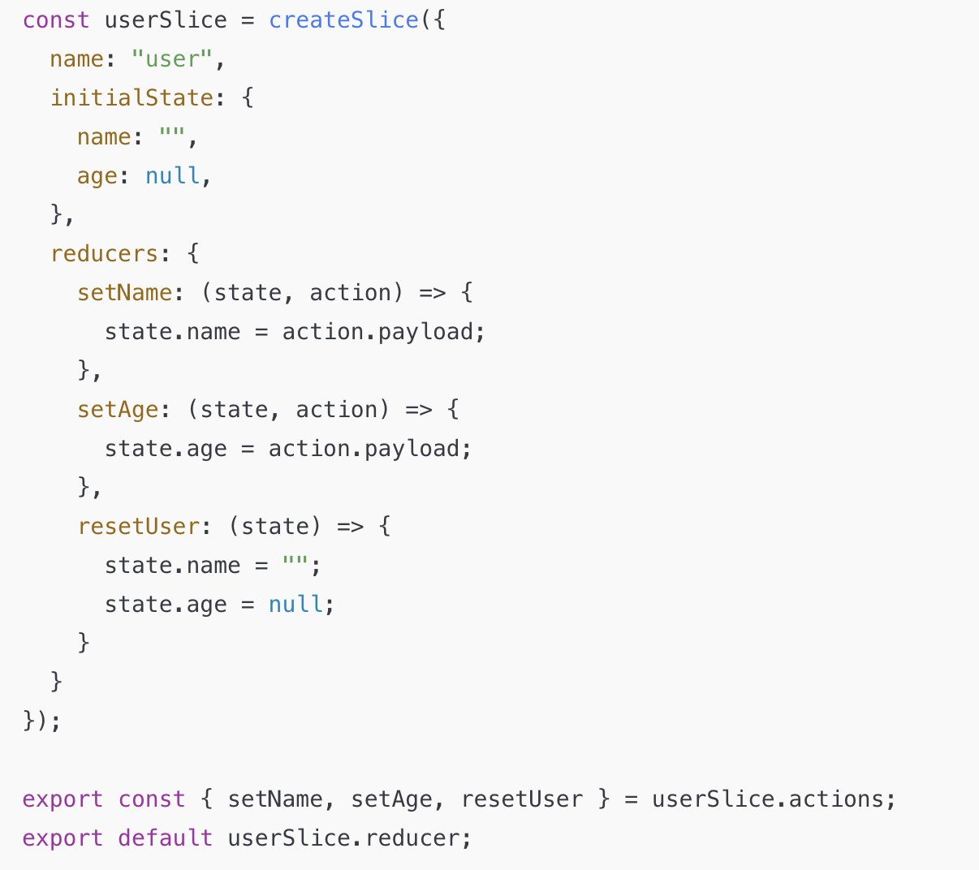

Slide 15
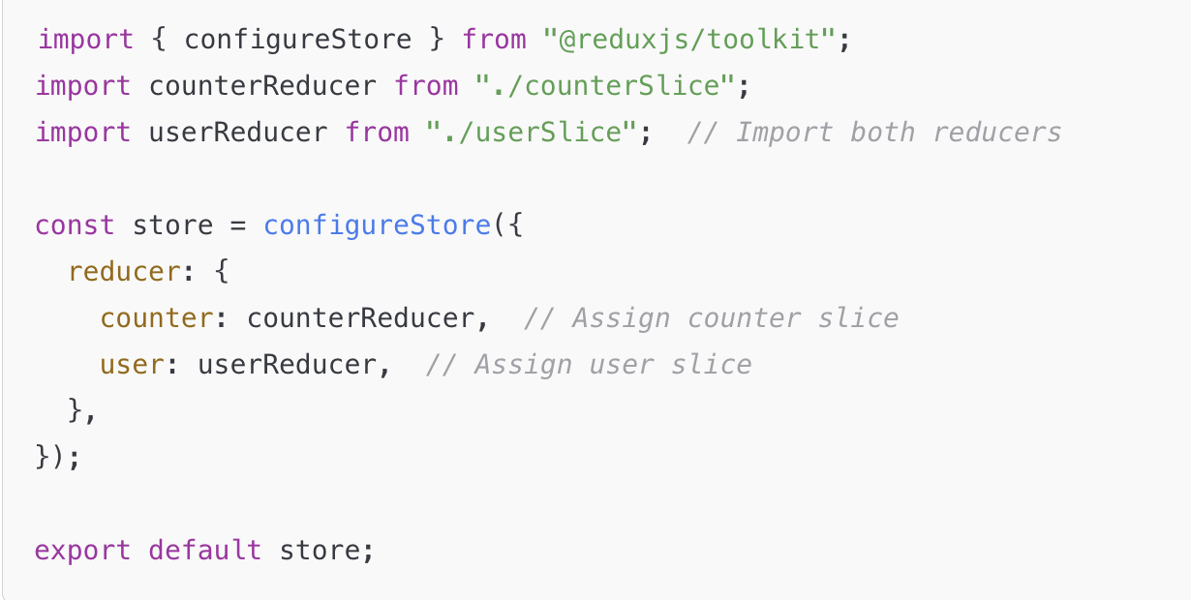
Store.js

Slide 16
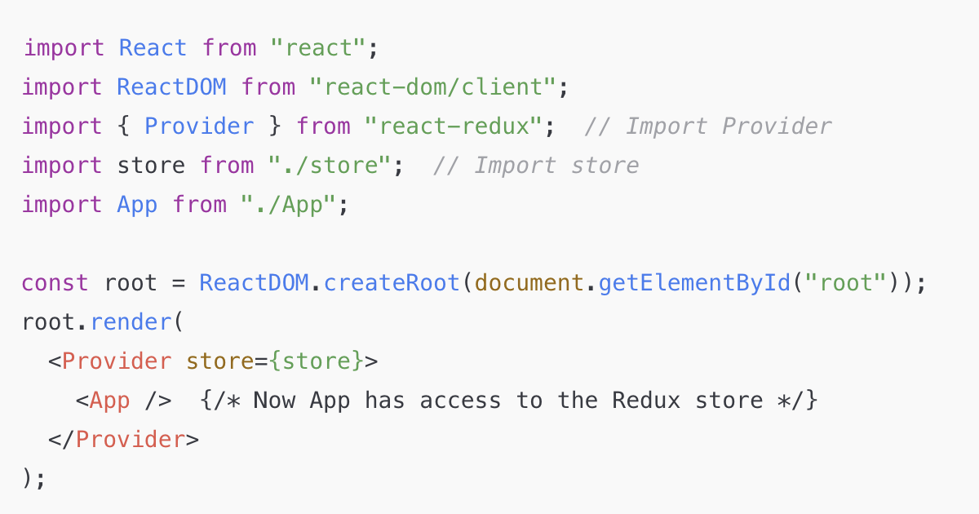
Index.js

Slide 17
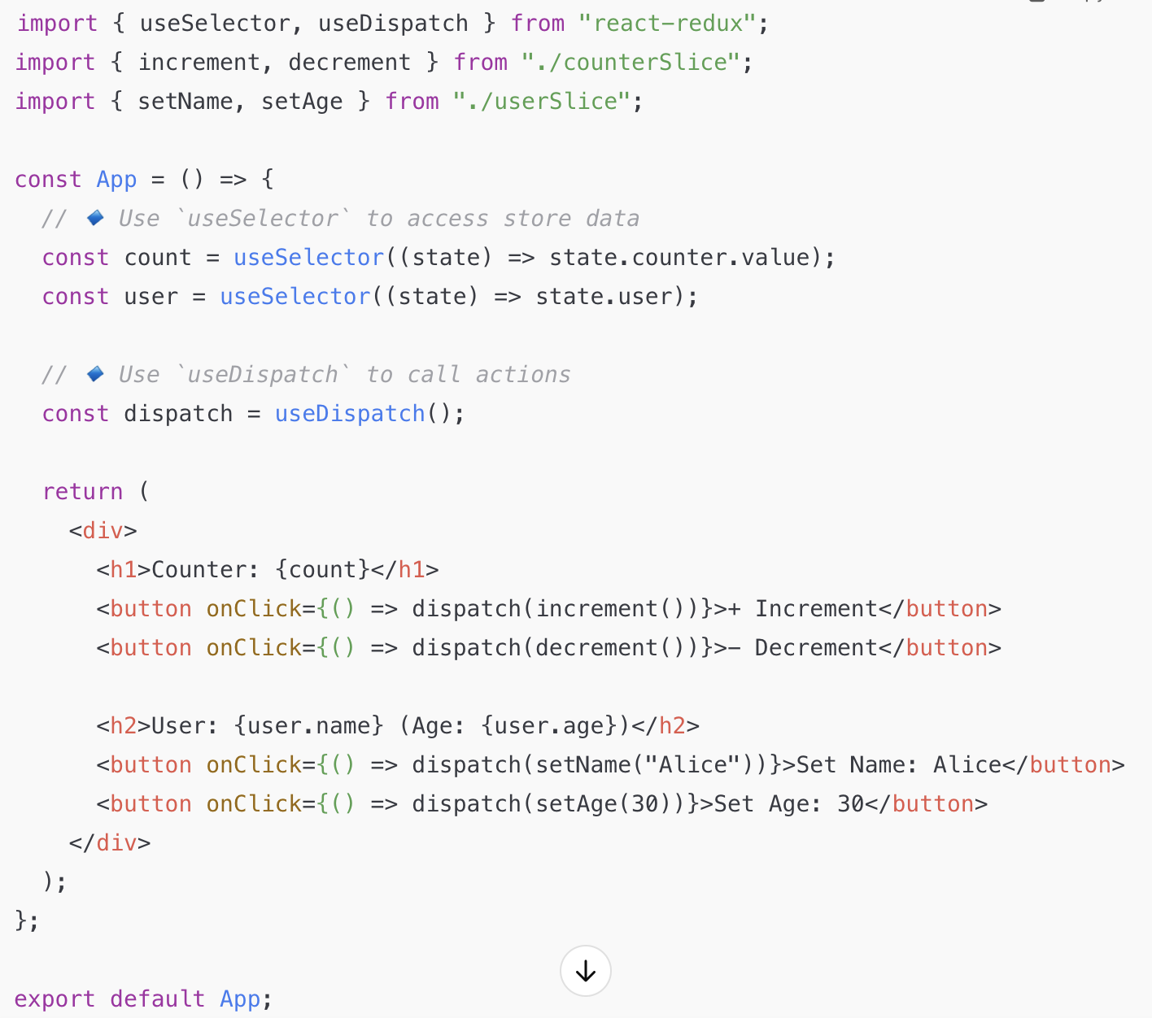
Selector + Dispatcher in App.js

Slide 18
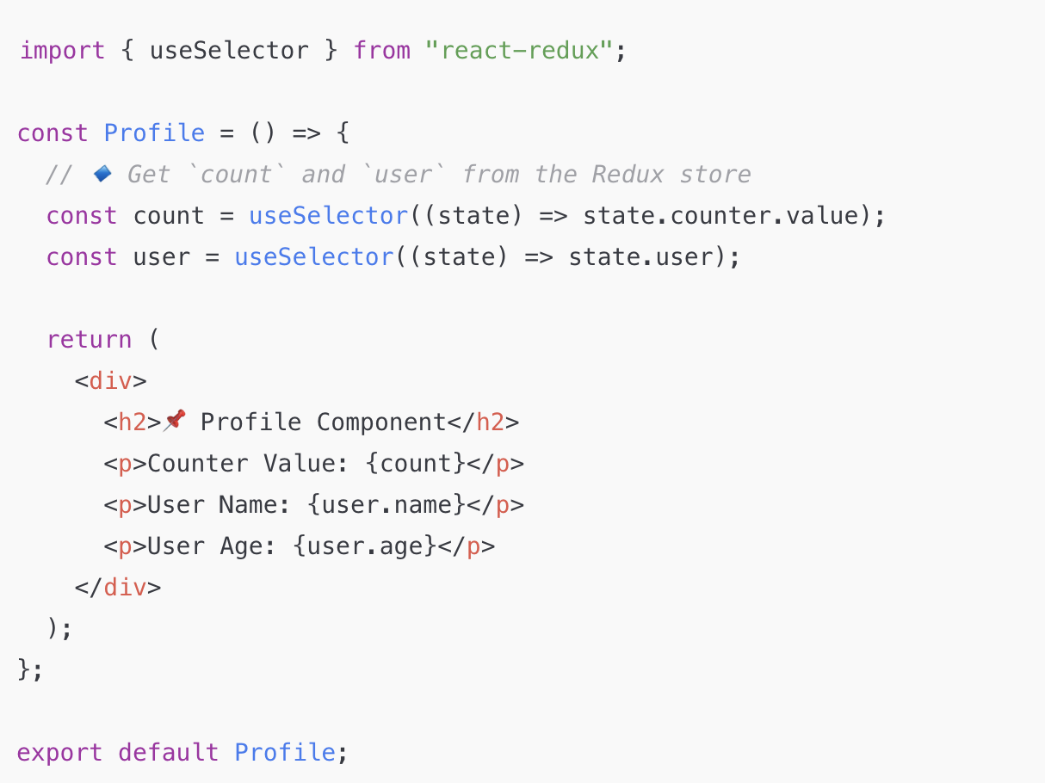
Selector in Profile Component

Slide 19
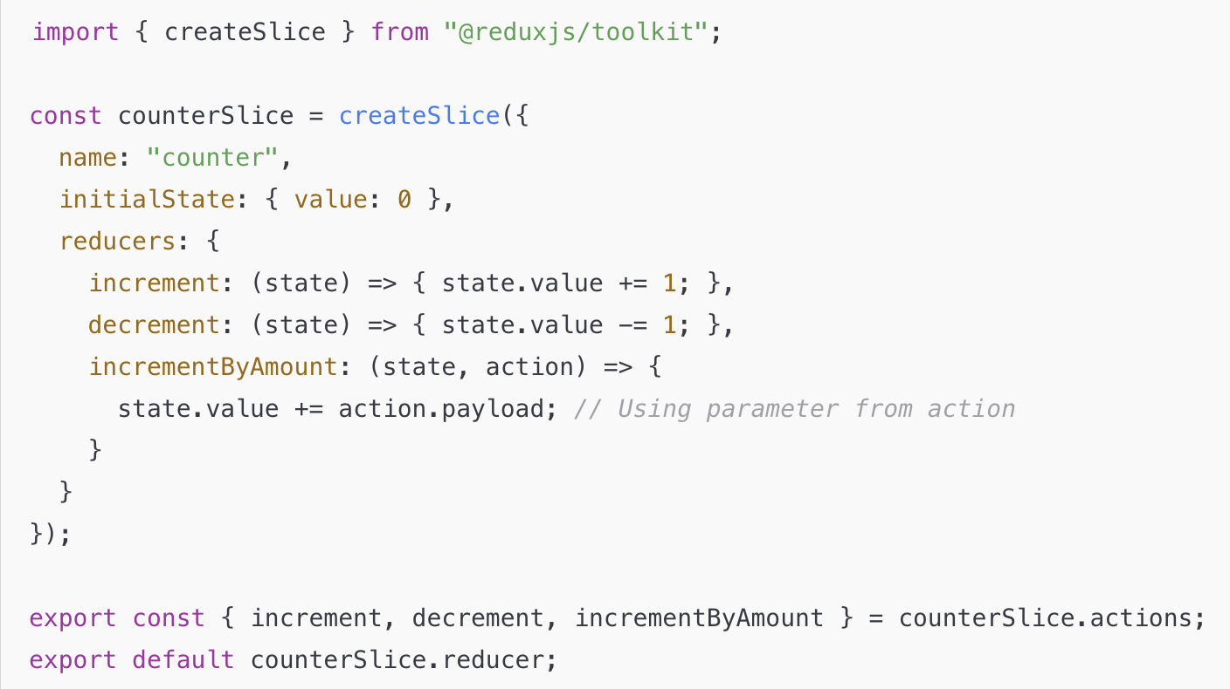
Slice with parameters
<button onClick={() => dispatch(incrementByAmount(5))}>Increment by 5</button>

Slide 20
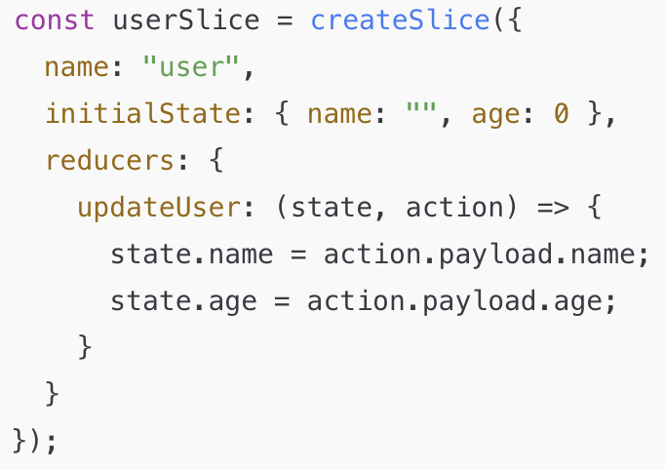
Slice with multiple parameters
dispatch(updateUser({ name: "Alice", age: 30 }));

Slide 21
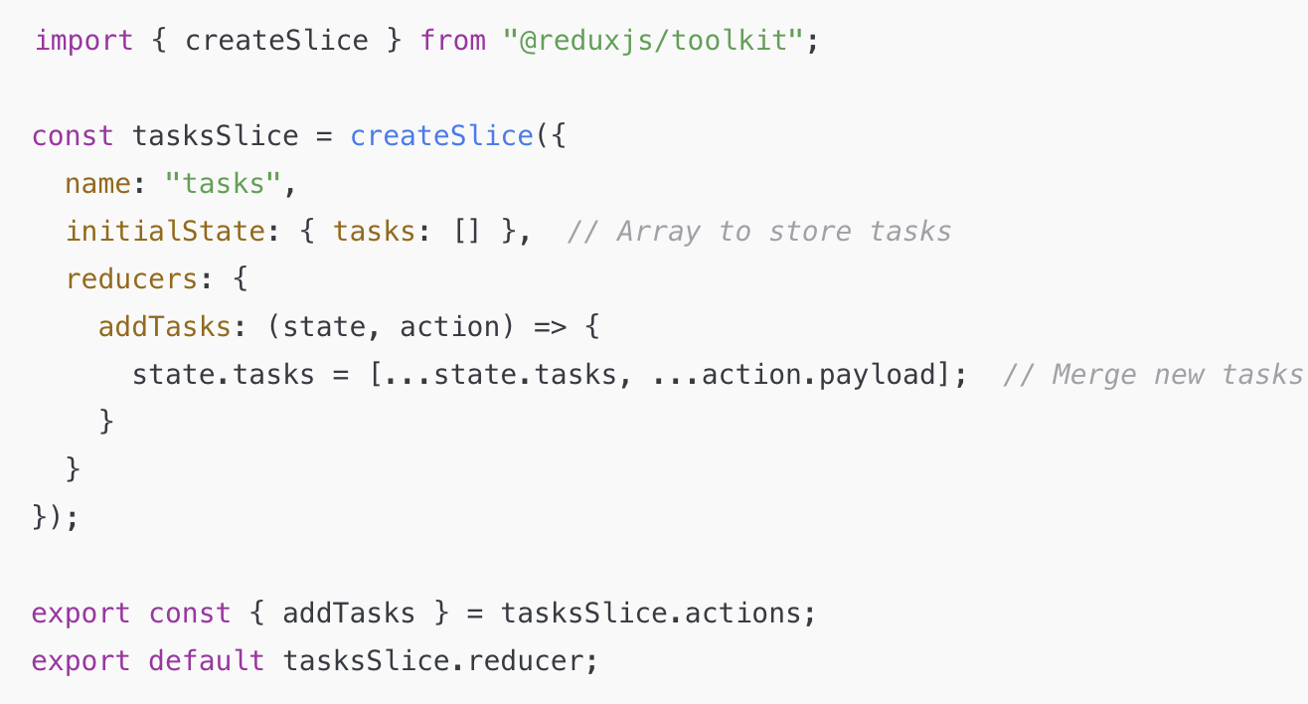
Add tasks - array params
const newTasks = ["Buy groceries", "Complete project", "Read a book"];
dispatch(addTasks(newTasks));

